Slide 1

Data Mining & Machine Learning I
2. Data Preprocessing & Transformation

Slide 2
2. Data Preprocessing & Transformation
2.1 Prediction
2.2 Data Characteristics
2.3 Data Preprocessing
2.4 Summary

Slide 3
2.1 Prediction
Introduction
Predictive Analysis
Classification
Process of finding a model (function) that describes and distinguishes data classes or concepts
Many different approaches and methods
Predict categorical (discrete/unordered) labels
Regression
Models continuous-valued functions
Predict missing/unavailable numerical data values
Different approaches here also
Regression analysis
Trend analysis
Classification
Regression

Slide 4
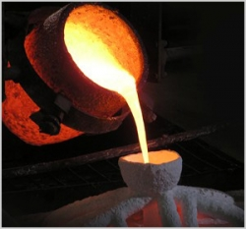
2.1 Prediction
Introduction
Approaches / Techniques
Combination of techniques from a variety of domains
Statistics
Statistical models
Descriptive / Inferential Statistics / Hypothesis Tests etc.
Machine Learning
Supervised / Unsupervised / Semi-supervised / Active Learning
Database Systems
Query language extensions
OLAP
Information Retrieval
Language models
Topic models
Search engines

Slide 5
2.2 Data Characteristics
Getting to Know Your Data
Data Attributes & Data Values
Data
What type of attributes make up the data?
What kind of values do these attributes have?
Are attribute values discrete or continuous?
How are values distributed?
Are we missing any data values?
Can we identify any outliers?

Slide 6
2.2 Data Characteristics
Getting to Know Your Data
Attribute Types
The type of an attribute is determined by the set of possible values
Data
An attribute is a data field representing a characteristic or feature of a data object.
Nominal
Binary
Also consider …
Ordinal
Continuous
Numeric
Discrete

Slide 7
2.2 Data Characteristics
Nominal Attributes
Represent the names of things
Also known as categorical attributes
No meaningful order associated with the possible values
Can be encoded numerically (if necessary)
Examples
Eye colour
Climate type
Gender
Data
Any possibly useful descriptive statistics?

Slide 8

2.2 Data Characteristics
Binary Attributes
A nominal attribute with only two states
Typically
0 represents absence of a particular quality or falsehood of a state
1 represents presence of a particular quality or truth of a state
A binary attribute is said to be symmetric if both states are considered equally valuable and carry the same weight.
A binary attribute is asymmetric if the states are not considered of equal weight. For example, indicator for the presence of a disease. In such cases, by convention, the rarest state is usually assigned the value 1.

Slide 9

2.2 Data Characteristics
Ordinal Attributes
Possible values have a meaningful order or ranking
Magnitude between successive values not known
Examples
Small, Medium, Large
Military Rank
Survey rankings
May also arise as a result of data reduction/discretization processes.
Any possibly useful descriptive statistics?

Slide 10




2.2 Data Characteristics
$$ℝ$$
Numeric Attributes
Quantitative
Measurable quantity
Interval-Scaled Values
Ordered
Positive, Zero, Negative
Can compare and quantify differences between values
Examples
Temperature
Years
$$ℤ$$
$$ℕ$$
$$ℚ$$
It doesn’t make sense though to say that a certain temperature is twice as warm as another temperature.
We cannot speak of the values in terms of ratios.

Slide 11
2.2 Data Characteristics
$$ℝ$$
Numeric Attributes
Quantitative
Measurable quantity
Ratio-Scaled Values
Inherent Zero point
Can speak of one value being a multiple of another value in terms of ratios
Can compare and quantify differences between values
Examples
Number of people in a room
Height
Weight
$$ℤ$$
$$ℕ$$
$$ℚ$$
Any possibly useful descriptive statistics?

Slide 12
2.2 Data Characteristics
Descriptive Statistics
Variance
Mean
Interquartile Range
Median
Mode
Weighted Mean
Quartiles
Standard Deviation
Range

Slide 13
2.2 Data Characteristics
Descriptive Statistics
Boxplots
Q-Q Plots
Scatter Plots
Histograms
Other Visualizations

Slide 14
2.3 Data Preprocessing
Overview
Data Cleaning
Data Integration
Data Transformation
Data Reduction

Slide 15
2.3 Data Preprocessing
Overview
Data Quality
To what extent is the data fit to satisfy its intended use?
We can consider a number of factors
Accuracy
Completeness
Consistency
Veracity
Provenance
Timeliness
Interpretability
…
Unfortunately, and typically, datasets will not exhibit these desired qualities!!

Slide 16
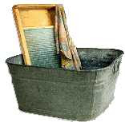
2.3 Data Preprocessing
Data Cleaning
Handle missing values
Remove noise / smooth noisy data
Identify / remove outliers
Resolve inconsistencies

Slide 17
2.3 Data Preprocessing
Data Cleaning
Missing Values
Ignore the data tuple
Manually fill in data values
Use global constants (e.g., ’UNKNOWN’)
Use a measure of central tendency
Need to check data distribution
Use mean/median values based for samples of the same class
Use probabilistic / regression / ML methods

Slide 18
2.3 Data Preprocessing
Data Cleaning
Noisy Data
Random errors, fluctuations, variance can be introduced into data
Descriptive statistical methods can be used to aid in the identification of outliers that may be the result of noise impacting on data values
Binning induces a local smoothing of data
Smoothing by bin means
Smoothing by bin medians
Smoothing by bin boundaries
Regression
Linear regression
Multiple linear regression
Outlier Analysis
Clustering techniques
Concept Hierarchies
Some ML methods may inherently smooth data (e.g., ANN)

Slide 19
2.3 Data Preprocessing
Data Cleaning
Practicalities / Supporting Processes
Take into account metadata considerations
Datatypes
Constraints
Uniqueness
Incremental data values
Nullable fields
Known interdependencies between attribute values
Identify inconsistent data value representations
Is Field Overloading evident?
Data validation tools
Data Migration / ETL / ELT processes
Once discrepancies have been identified – how do we handle data issues?

Slide 20

2.3 Data Preprocessing
Data Integration
Merging and combining data from multiple datasources
Aid with discrepancy detection
Many challenges
Entity Identification Problem
Schema matching
Resolution of conflicting data values
Check for correlations
Tuple similarity

Slide 21
2.3 Data Preprocessing
Data Integration
Entity Identification Problem
Reliance on metadata and/or domain/instance data
Take two (or more) database schemas to produce a mapping between attributes that correspond sematically to each other
Merge into a global schema
Semi-automatic / heuristics can identify candidates
Challenges
Different datatypes
Different attribute names
Similar values used for different reasons

Slide 22
2.3 Data Preprocessing
Data Integration
Entity Identification Problem
Schema-Level Matching
Consider the match cardinality
Linguistic Approaches
Name matches
Synonyms/Hypernyms
Commonly used substrings
Cosine similarity
Description matches
Based on comments in schema definitions
Constraint Based Approaches
Data types
Value ranges
Uniqueness
Etc.

Slide 23
2.3 Data Preprocessing
Data Integration
Entity Identification Problem
Domain and Instance-Level Matching
Value characteristics exploited to match schema elements
Domain of values
Simple domain of values
ISBN
Currency amounts
Composite domain of values
DD/MM/YYYY
Invoke a matcher program to compute similarities. May use ML / Clustering approaches.

Slide 24

2.3 Data Preprocessing
Data Integration
Redundancy & Correlation Analysis
Some values may be derived from others
May be detected by correlation analysis
$χ^{2}$ test
Used with nominal data
Correlation coefficients / covariance
Used with numeric data

Slide 25
2.3 Data Preprocessing
Data Integration
Tuple Duplication
Denormalized data tables may introduce redundancies
Deduplication processes
Semi-automated approaches
System design / update can support these processes
Data Value Conflict / Resolution
Different recorded values associated
with the same base entity
Granularity concerns

Slide 26
2.3 Data Preprocessing
Data Reduction
Why?
Time
Energy
Efficiency
The purpose of data reduction is to obtain a reduced representation of the data that is smaller in volume, yet closely maintains the integrity of the original data
Dimensionality Reduction
Numerosity Reduction
Compression Techniques

Slide 27
2.3 Data Preprocessing
Data Reduction
Dimensionality Reduction
Reduce the number of attributes under consideration
PCA
Signal Processing Techniques (e.g., Fourier/Wavelet Transforms)
Removal of redundant data
Clustering Approaches
Sampling

Slide 28
2.3 Data Preprocessing
Data Reduction
Dimensionality Reduction
Principal Components Analysis
Assume data described by n attributes
Search for k n-dimensional orthogonal vectors that can be best used to represent the data (k <= n)
Original data is projected onto a smaller space
PCA combines attributes to create a new basis and then expresses the original vectors in terms of this new basis

Slide 29
2.3 Data Preprocessing
Data Reduction
Dimensionality Reduction
Principal Components Analysis
Normalize input data
Compute k orthonormal vectors to provide a new basis for the normalized input data. These basis vectors are the principal components. The input data is expressed as a linear combination of the principal components
The principal components are sorted in order of
decreasing significance. The first axis will account for
the most variance among the data and so on.
The weaker / less significant axes can be eliminated

Slide 30
2.3 Data Preprocessing
Data Reduction
Dimensionality Reduction
Principal Components Analysis
Can handle ordered / unordered data
Can handle sparse data
Can handle skewed data
Can be used as an input into regression models / cluster analysis

Slide 31
2.3 Data Preprocessing
Data Reduction
Dimensionality Reduction
Attribute Subset Selection / Feature Selection
Domain expertise?
Reduce the data by removing irrelevant/redundant attributes by finding a minimum set of attributes such that the resulting probability distribution of data classes is as close as possible to the original distribution using all the attributes
Heuristic methods explore a reduced search space
Greedy – make the best choice at a given time in the
processing
Make a locally optimal choice that (hopefully) results in
a globally optimal solution
Attribute selection based on statistical tests of significance
under assumptions of attribute independence and/or measures
of information gain etc.

Slide 32
2.3 Data Preprocessing
Data Reduction
Dimensionality Reduction
Attribute Subset Selection / Feature Selection
Greedy / Heuristic Methods
Stepwise Forward Selection
Start with empty set of attributes
Add ‘best’ attribute
Iterate
Stepwise Backward Selection
Start with full set of attributes
Remove ‘worst’ attribute
Iterate
Decision Tree Induction

Slide 33
2.3 Data Preprocessing
Data Reduction
Dimensionality Reduction
Clustering Approaches
Data instances are grouped into clusters so that ‘similar’ instances are in the same cluster
Cluster representations of data can be used to replace the original instances thus resulting in data reduction
Sampling
With replacement
Without replacement
Stratified sampling

Slide 34
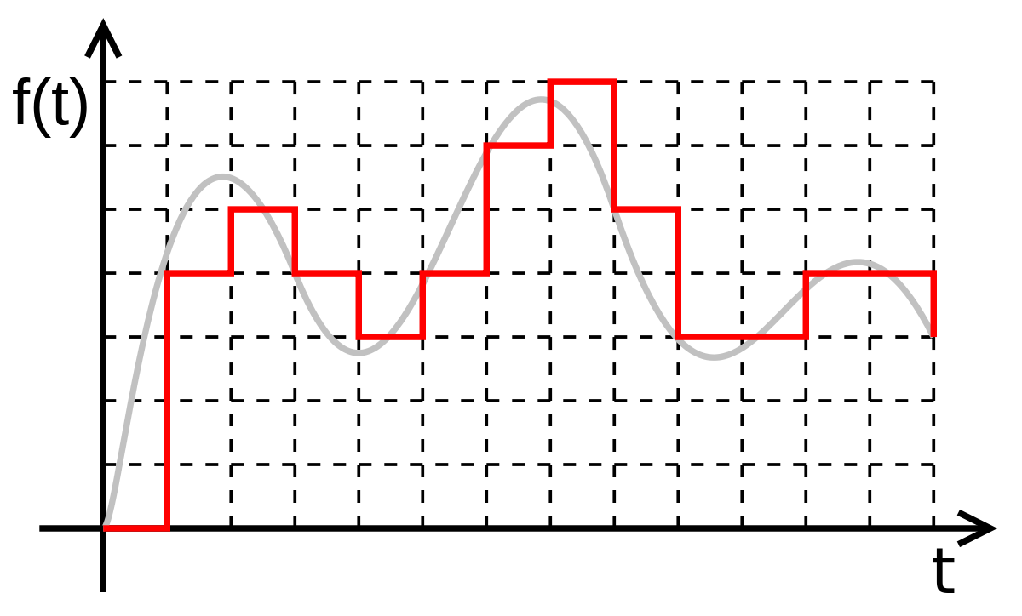
2.3 Data Preprocessing
Data Transformation & Discretization
Transform data to
Facilitate mining processes
Increase interpretability of data
Various Strategies
Smoothing
Attribute construction
Aggregation
Normalization
Discretization
Concept Hierarchies

Slide 35
2.3 Data Preprocessing
Data Transformation & Discretization
Transform data to
Facilitate mining processes
Increase interpretability of data
Various Strategies
Smoothing
Attribute construction
Aggregation
Normalization
Discretization
Concept Hierarchies
Note: Overlap between preprocessing tasks.

Slide 36
2.3 Data Preprocessing
Data Transformation & Discretization
Normalization
Consideration must be given to units of measurement
Expression of values in smaller units of measurement will generally lead to larger ranges for the attribute in question which may result in a greater weight being assigned to such an attribute
To counter this effect we can normalize or standardize the attribute values
Data transformed so that it falls within defined ranges
E.g.,
[-1,1]
[0.0, 1.0]

Slide 37
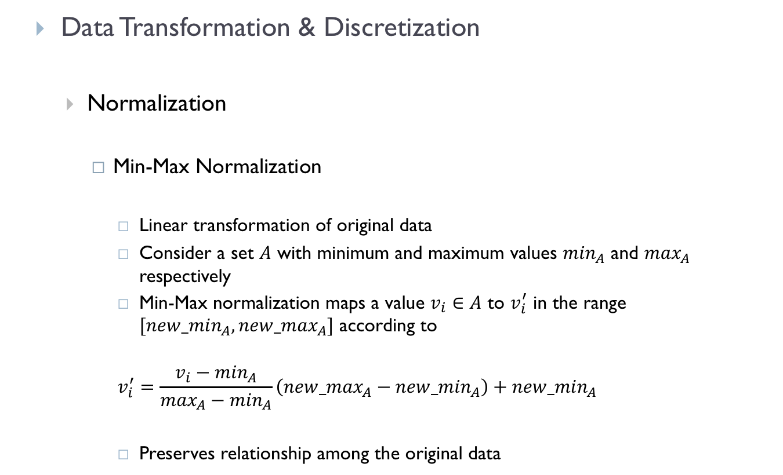
2.3 Data Preprocessing
Data Transformation & Discretization
Normalization
Min-Max Normalization
Linear transformation of original data
Consider a set $A$ with minimum and maximum values $\min_{A}$ and $\max_{A}$ respectively
Min-Max normalization maps a value $v_{i}∈A$ to $v_{i}^{′}$ in the range $[{new_min}_{A},{new_max}_{A}]$ according to
$$v_{i}^{′}=\frac{v_{i}−\min_{A}}{\max_{A}−\min_{A}}\left({new_max}_{A}−{new_min}_{A}\right)+{new_min}_{A}$$
Preserves relationship among the original data

Slide 38

2.3 Data Preprocessing
Data Transformation & Discretization
Normalization
Z-Score Normalization
Uses mean and standard deviation
$$v_{i}^{′}=\frac{v_{i}−\overline{A}}{σ_{A}}$$
Useful when actual min and max values are unknown or
when outliers dominate min-max normalization

Slide 39

2.3 Data Preprocessing
Data Transformation & Discretization
Normalization
Decimal Normalization
Normalize by dividing by a scale factor
$$v_{i}^{′}=\frac{v_{i}}{{10}^{j}}$$
where $j$ is the smallest integer such that $\max\left(\left|v_{i}^{′}\right|\right)<1$ .

Slide 40
2.3 Data Preprocessing
Data Transformation & Discretization
Discretization
Binning
A top-down splitting technique based on a specified number of bins
Can be applied using equal-width or equal-frequency binning with bin values being replaced with mean or median values
Can be applied recursively
Sensitive to outliers

Slide 41
2.3 Data Preprocessing
Data Transformation & Discretization
Discretization
Histogram Analysis
Histograms partition values of an attribute into disjoint ranges called buckets (or bins)
Also can utilise equal-width or equal-frequency parameterisations
Cluster / Decision Tree / Correlation Analyses
What about nominal data?

Slide 42

2.4 Summary
Prediction
Data Characteristics
Data Preprocessing
Bibliography/References
Han J., Kamber M., Pei J. (2012). Data Mining Concepts and Techniques. Morgan Kaufmann.
Bing L. (2011). Web Data Mining. Springer.

